Slide 1
Lecture 3
Linear Regression as Machine Learning Algorithm Examples

Slide 2
Introduction
In this lecture we present some examples to illustrate how linear regression is used in machine learning
Machine learning handles usually large data sets
The examples we present here are oversimplified and serve only for illustration purposes
Notes:
In this lecture we present some examples to illustrate how linear regression is used in machine learning
Note that machine learning handles usually large data sets
Keep in mind that the examples we present here are oversimplified and serve only for illustration purposes

Slide 3
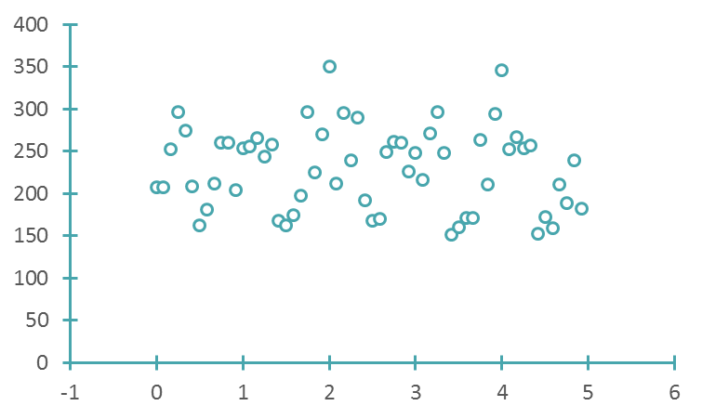

Annual Power Generation of a Windmill
$m=60$ entries
Years since Jan 2005 | Power Generation [MW]
0 | 207
0.083333 | 207
0.166667 | 253
0.25 | 296
… | …
Power Generation [MW]
Years since 2005
Notes:
Ref for data: http://www.minnkota.com
The first example deals with the annual power generation of a windmill
The table lists, monthly since January 2005, the average power generation, in MW, of a windmill in eastern North Dakota in the USA
The dataset we use contains a total of 60 entries

Slide 4


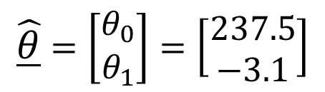

Annual Power Generation of a Windmill
Using a linear model with one feature (time since 2005)
$$y=θ_{0}+{θ_{1}x}_{1}$$
$$y=\text{Power} \text{generation}$$
$$x_{1}=t=\text{Years} \text{since}\text{ 2005}$$
Power Generation [MW]
$$\underline{\hat{θ}}=\left[\begin{matrix}θ_{0} \\ θ_{1}\end{matrix}\right]=\left[\begin{matrix}237.5 \\ −3.1\end{matrix}\right]$$
Years since 2005
Notes:
Let us first try out a very simple model containing a single feature x1, which is the time t, in fraction of years, since January 2005
The model writes then $y=θ_{0}+{θ_{1}x}_{1}$
If you use the normal equations to train this model you will find the optimal feature weights $\underline{\hat{θ}}$ that gives you a minimal error in representing the data set
As obvious form the plot, the model isn't that great
This is not surprising as the data set doesn’t look very linear to being with

Slide 5
Using Octave / Matlab
The example assumes you entered the data in two column vectors t and y in octave
octave> x1=t;
octave> A=[x1.^0 x1];
octave> theta = A’*A\A’*y
ans =
237.5459
-3.1102
octave> yfit=A*theta;
octave> plot(t, yfit, ‘-’, t, y, ‘o’)
Notes:
Let us quickly explain once more how you can train your model using octave
First you will have to the enter the data set
Let us assume you created two column vectors t and y
The vector t contains the time, in fraction of years, since January 2005
The vector y contains the corresponding average power generation in MW
Having these two vector available we define now our feature vector x1
From this vector we create the usual way our coefficient matrix A
The first column is made out of ones, the second column is the feature vector x1
Solving the normal equations using PA=LU decomposition gives us our optimal feature weights
To create a plot of our model we can first compute the labels y according the model of our data set
Having stored thse labels in the vector yfit we can then plot them together with the data points

Slide 6





Annual Power Generation of a Windmill
Using a periodic model with three features
$$y=θ_{0}+{θ_{1}x}_{1}+{θ_{2}x}_{2}+{θ_{3}x}_{3}$$
$$x_{1}=\cos{2πt}$$
$$x_{2}=\sin{2πt}$$
Power Generation [MW]
$$x_{3}=\cos{4πt}$$
$$\underline{\hat{θ}}=\left[\begin{matrix}{\hat{θ}}_{0} \\ \begin{aligned}{\hat{θ}}_{1} \\ {\hat{θ}}_{2} \\ {\hat{θ}}_{3}\end{aligned}\end{matrix}\right]=\left[\begin{matrix}229.9 \\ \begin{aligned}39.3 \\ 14.5 \\ −26.7\end{aligned}\end{matrix}\right]$$
Years since 2005
Notes:
As we realized, the simple model with one feature isn’t that great
Let us try a more realistic model involving three features x1, x2 and x3
The first feature x1 is defined as $\cos{2πt}$
And the second feature as $\sin{2πt}$
As t is measure in fraction of years, these two features will measure half annual fluctuations
This makes sense as probably winter and spring may require similar power generation as summer and fall
But you may expect that the power generation should not only depend on an half annual cycles, but on seasons too. For example winter and summer will not ask for the same power generation
This is why we define the third feature as $\cos{4πt}$ to capture more fine variations
Training this model gives a much better description of the data set as obvious from the plot
One can very well see how at start of the year and end (in winter) power generation is high, as the demand is high too. In spring the power generation decreases and in summer the power generation is the lowest. In fall power generation increases again before becoming maximal in winter
This example illustrates well why in machine learning people talk about features
In fact in our example the features x1 and x2 capture the variations due to cold and warm seasons
Whereas the third feature captures variations du to all four seasons

Slide 7
Using Octave / Matlab
The example assumes you entered the data in two column vectors t and y in octave
octave> x0=t.^0;
octave> x1=cos(2*pi*t);
octave> x2=sin(2*pi*t);
octave> x3=cos(4*pi*t);
octave> A=[x0 x1 x2 x3];
octave> theta = A’*A\A’*y
ans =
229.900
39.348
14.522
-26.717
octave> yfit=A*theta;
octave> plot(t, yfit, ‘-’, t, y, ‘o’)
Notes:
Let us quickly show how you solve this problem in octave
Let us assume you created two column vectors t and y
The vector t contains the time, in fraction of years, since January 2005
The vector y contains the corresponding average power generation in MW
We create than four vectors
xo is made out of ones only
x1 to x3 are the three feature vectors
The coefficient matrix A is straightforward to build using our four vectors x0, x1, x2 and x3
Solving the normal equations gives us our optimal feature weights
The same way as in the simple model with one feature, we can compute the labels predicted by our trained model corresponding to the various data points and plot them together with the data points

Slide 8
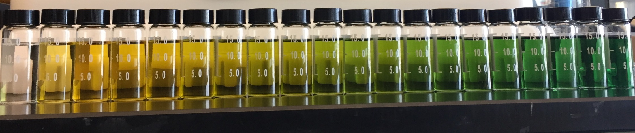
Quality of electropolishing
Electropolishing is an electrochemical process in which a workpiece surface roughness can be reduced
It takes place in an electrochemical bath
As more and more polishing happens in a same bath, the physical and chemical properties of it changes
Notes:
In this second example we will apply machine learning to a manufacturing process
We consider electro polishing of stainless steel.
Electropolishing is an electrochemical process in which the surface roughness of a a workpiece can be reduced
The process takes place in an electrochemical bath
Depending the industry, an electropolishing bath can be very large, the size of a swimming pool for example
The problem is that the more and more polishing happens in a same bath, the physical and chemical properties of it changes
The consequence is that polishing quality changes too and the polishing parameters need constantly to be adjusted
The figure on the slide shows samples taken from a polishing bath. The most left, the transparent sample, is a fresh bath. The most right sample, the dark green one, is a sample taken from a polishing bath where significant amount of polishing took place. The color change, from transparent, passing by yellow until dark green, is due to the accumulation of metal ions during the polishing process. Mainly the nickel ion is responsible for the green color change

Slide 9
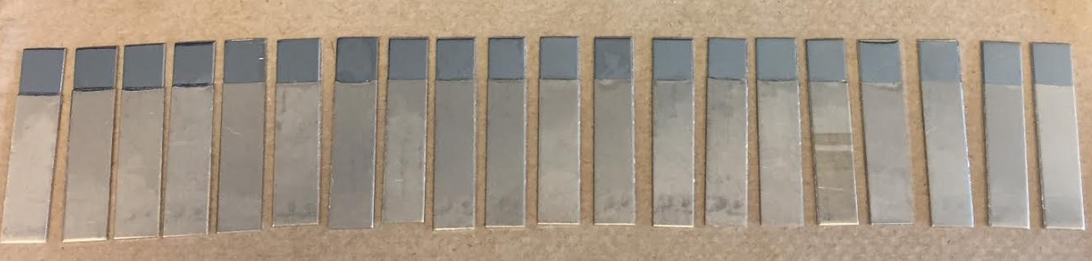

Quality of electropolishing
For different bath compositions different surface roughness result
Specific gravity SG of polishing bath [] | Surface roughness Ra [μm]
1.5754066 | 0.055
1.5798733 | 0.082
1.5829733 | 0.091
1.5874866 | 0.106
… | …
$m=20$ entries
Roughness Ra [μm]
Specific gravity SG []
Notes:
A simple and fast way to observe the increase of metal ions in the polishing bath is through its specific gravity
The more ions are present in the polishing solution, the more the specific gravity is increasing
The dataset we deal with in this example contains values of measured specific gravity of polishing bath at various ages and the surface roughness obtained on polishing a standard workpiece under standard polishing
Parameters
The image shows some these standard workpieces and one can observe how polishing degrades from the left to the right. The left sample, the very bright one, was polished in a fresh bath and the most right, the matt sample, was polished in the oldest bath
The database contains 20 instances and the displayed graph shows the dependence of the surface roughness with the specific gravity of the polishing bath
A none-linear relation is observed

Slide 10





Quality of electropolishing
Using a second order polynomial model with two features
$$y=θ_{0}+{θ_{1}x}_{1}+{θ_{2}x}_{2}$$
$$y=\text{Roughness}$$
$$x_{1}=\text{SG}$$
$$x_{2}={\text{SG}}^{2}$$
Roughness Ra [μm]
$$\underline{\hat{θ}}=\left[\begin{matrix}{\hat{θ}}_{0} \\ \begin{aligned}{\hat{θ}}_{1} \\ {\hat{θ}}_{2}\end{aligned}\end{matrix}\right]=\left[\begin{matrix}\begin{aligned}388.5 \\ 494.0 \\ 157.1\end{aligned}\end{matrix}\right]$$
Specific gravity SG []
Notes:
We will use a second order polynomial model to fit the data set
For this we define two features x1 and x2
X1 is the specific gravity SG of the polishing bath and x2 is the specific gravity squared
The model writes then $y=θ_{0}+{θ_{1}x}_{1}+{θ_{2}x}_{2}$ and we need to find the three features weights $θ_{0}$, $θ_{1}$ and $θ_{2}$
Solving the normal equations leads to the optimal feature weights and the plot shows the fitted model to the data set
A good fit is observed

Slide 11
Using Octave / Matlab
The example assumes you entered the data in two column vectors sg and y in octave
octave> x0=sg.^0;
octave> x1=sg;
octave> x2=sg.^2;
octave> A=[x0 x1 x2];
octave> theta = A’*A\A’*y
ans =
388.52
-494.00
157.05
octave> yfit=A*theta;
octave> plot(t, yfit, ‘-’, t, y, ‘o’)
Notes:
Let us quickly explain how you train this model with octave.
It follows the same strategy that we start to get used to it
We assume that you have defined two vectors
The column vector SG contains the value of the specific gravity of the polishing baths and y contains the surface roughness of the standard work-pieces polished under standard polishing parameters
With this two vectors we start by defining the vectors xo as a column vector made of ones,
The vector x1, the first feature, the column vector equal to the specific gravity
and x2, the second feature, the column vector made of the square of the specific gravity
The coefficient matrix A of the inconsistent equations is then built column by column
Solving, by PA=LU decomposition, the normal equations gives us the trained feature weights
We can computed the predicted labels by multiplying A by the trained feature weights and plot them together with the data set to inspect visually the quality of the fit

Slide 12

Rating of cereals by consumers
Data about cereals ($m=77$)
Calories
Fat
Sodium
Fiber
Sugar
Vitamins
Rating
Can we learn consumer rating?
Notes:
In this third example we discuss how we can analyze consumer ratings of cereals
For this we use a data set containing 77 entries. Each entry contains several fields with properties of the rated cereals and the rating itself
Can we learn form this data set how consumers rate cereals?

Slide 13



Rating of cereals by consumers
Intuitively sugar content should affect rating
$$y=θ_{0}+{θ_{1}x}_{1}$$
$$y=\text{consumer} \text{rating}$$
$$x_{1}=\text{sugar} \text{content}$$
Rating
$$\underline{\hat{θ}}=\left[\begin{matrix}{\hat{θ}}_{0} \\ \begin{aligned}{\hat{θ}}_{1}\end{aligned}\end{matrix}\right]=\left[\begin{matrix}\begin{aligned}59.3 \\ −2.4\end{aligned}\end{matrix}\right]$$
Sugar content [g]
Notes:
Intuitively we can expect that the sugar content of cereals will affect the consumer rating
For this we use a model with the single feature x1 which is the sugar content of the rated cereals
The output y is the consumer rating on a scale of 100
Solving the normal equations lead to the feature weights minimizing the root mean square error
Observing the plot displaying the 77 instances and the fitted model show that the over trend seems to be reproduced but the variations are relatively large
According this data set, generally consumers prefer cereals with lower suggar content

Slide 14


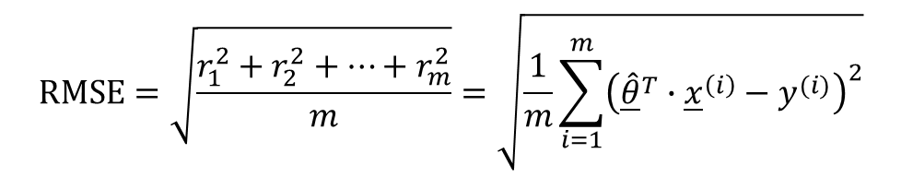

Rating of cereals by consumers
Root mean square error
$$\text{RM}\text{SE}=\sqrt{\frac{r_{1}^{2}+r_{2}^{2}+…+r_{m}^{2}}{m}}=\sqrt{\frac{1}{m}\sum_{i=1}^{m}{{\left({\underline{\hat{θ}}}^{T}∙{\underline{x}}^{\left(i\right)}−y^{(i)}\right)}^{2}}}$$
Residuals $r_{i}$
$$\text{RMSE}=9.0$$
Sample $i$
Notes:
To have a more quantitative description of the validity of the fit we consider the residuals
The residual plot gives a good idea on how the model is able to describe the data set.
One can observe that in average the residuals show an error, in absolute value, of around 10, which means that the model predicts the consumer rating with an average error of around 10.
The consumer rating being on a scale of 100, this means an average error around 10%
An objective measure of this error is, as we know, the root mean square error
Calculating the root mean square error of our data set and model gives a value of about 9, confirming our observation from the residual plot

Slide 15






Rating of cereals by consumers
Improved model ($n=3$ features)
$$y=θ_{0}+{θ_{1}x}_{1}+{θ_{2}x}_{2}+{θ_{3}x}_{3}$$
$$y=\text{consumer} \text{rating}$$
$$\underline{\hat{θ}}=\left[\begin{matrix}{\hat{θ}}_{0} \\ \begin{aligned}{\hat{θ}}_{1} \\ {\hat{θ}}_{2} \\ {\hat{θ}}_{3}\end{aligned}\end{matrix}\right]=\left[\begin{matrix}53.4 \\ \begin{aligned}−2.0 \\ −3.5 \\ 3.0\end{aligned}\end{matrix}\right]$$
$$x_{1}=\text{sugar} \text{content}$$
$$x_{2}=\text{fat} \text{content}$$
$$x_{3}=\text{fiber} \text{content}$$
Notes:
A root mean square of 9 on a scale of 100 is quite large.
Let us try a model including more than one feature
This time we include three features: the sugar content, the fat content and the fiber content
Solving the normal equations lead to the feature weights minimizing the root mean square error
As out model has now 3 features, we can no longer plot the data set together with the fitted model as it would require a plot in four dimensions
This is very typical for machine learning which deals with situations involving a large amount of features.

Slide 16


Rating of cereals by consumers
Root mean square error
$$\text{RM}\text{SE}=\sqrt{\frac{r_{1}^{2}+r_{2}^{2}+…+r_{m}^{2}}{m}}=\sqrt{\frac{1}{m}\sum_{i=1}^{m}{{\left({\underline{\hat{θ}}}^{T}∙{\underline{x}}^{\left(i\right)}−y^{(i)}\right)}^{2}}}$$
Residuals $r_{i}$
$\text{RMSE}=5.$1
Sample $i$
Notes:
Not being able to plot the data set together with the fitted model leaves us with only the residual plot as a tool to judge if our model describes well or not the data set
Observing the residual plot and comparing it with the model having only one feature, tells us right away that the three feature model is better. The residuals are smaller and are in average with an absolute error around 5
Computing the root mean square error confirms this observation
We find a value of 5.1, almost half of the value we got in the case of the one feature model
This shows that sugar, fat and the fiber content are important factor affecting the consumer rating of cereals

Slide 17
Summary
We studied some examples where linear models involving serval features can be used to describe data sets
Comparing these examples allows us to get a better intuitive understanding about what are features
Features can represent
physical properties (e.g. sugar, fat or fiber content of cereals)
patterns in a data set (e.g. seasonal variations of power generation)
mathematical quantities needed to describe a data set (e.g. the first and second power of the specific gravity of an electropolihing solution
Notes:
Let us summarize the key findings
We studied some examples where linear models involving serval features can be used to describe data sets
Comparing these examples allows us to get a better intuitive understanding about what are features
Features can represent
physical properties (e.g. sugar, fat or fiber content of cereals)
patterns in a data set (e.g. seasonal variations of power generation)
mathematical quantities needed to describe a data set (e.g. the first and second power of the specific gravity of an electropolihing solution

